Slide 1
CMAC 3990.200 Systems Administration and Operations
Fall 2025 – Week 13.1 – November 18th, 2025
Cloud – Auto Scalers, Billing and Cost Management

Slide 2

Weekly Info
Go as far as you can see, and you will see further.
Zig Ziglar
Attendance & Good of the class
Assignment 12 – Due This Week!
Friday, November 21st, 2025
Presentation Reminder
Presentation Date: Tuesday, December 2nd, 2025
Assignment 13
Due Friday December 5th, 2025
Assignment AWS - Bonus
Due Friday December 5th, 2025
Remaining Points (715 total):
Attendance (weeks 13 & 15): 12 points
Presentation & Project: 300 points
2 Assignments (12-13): 137 points
60-75 points each
Final Exam: 266 points
Bonus AWS: 50 points
Final Exam
December 9th, 2025
5:00PM to 7:00PM

Slide 3

Remaining Class Schedule!
Week 13
Cloud, Auto Scalers, IAM
Week 14
No Class – Thanksgiving/fall break
Week 15
Student Presentations
Reviews and discussions
Automation, JQ, more…
Week 16 – Tuesday December 9th, 2025
Final Exam - 5:00PM - 7:00PM

Slide 4

Project
Provide a report and presentation on your chosen topic
Your report and presentation should contain the following:
Describe the standard definitions and terms
Walk through the history of the technology
Walk through what software/hardware you used and how
Documentation, description of services, implementation guide, etc.
References!
Presentation
5-10 minute discussion of your report
Basic implementation – How did you install?
Documentation of steps that can be given to a junior admin!
PowerPoint or another presentation showing steps with pictures will help!
Live examples where possible!

Slide 5
Presentations!
Provide a report and presentation on your chosen topic
Submit all report and presentation materials to D2L “Presentation” assignment folder
Due by the end of the day on Friday, December 5th, 2025.
Presentation
5-10 minute discussion of your report (~20mins max)
Basic implementation – How did you install?
Documentation of steps that can be given to a junior admin!
PowerPoint or another presentation showing steps with pictures will help!
Live examples where possible!
Going to randomize who goes first?
Unless someone wants to go first?

Slide 6
Amazon Web Services
EC2 – Elastic Compute Cloud – The Amazon Web Services component
Instance – Virtual Machine – A running VM, similar to our class VM’s
Amazon Machine Image (AMI) – Template – An OS installed and pre-configured to quickly deploy
Virtual Private Cloud (VPC) – Network – A virtual private non-routable network subnet
Internet Gateway (IGW) – Gateway/router – Next hop to the internet
Region – A generalized location where AWS physical services are located
Availability Zone – An individual data center within a region
Security Group – A virtual firewall
Elastic Load Balancer (ELB) – The Elastic Load Balancing Service from Amazon will automatically distribute incoming application traffic across multiple Amazon EC2 instances.
Load balancers allow you to achieve fault tolerance in your applications, seamlessly providing the required amount of load balancing capacity needed to route application traffic.

Slide 7
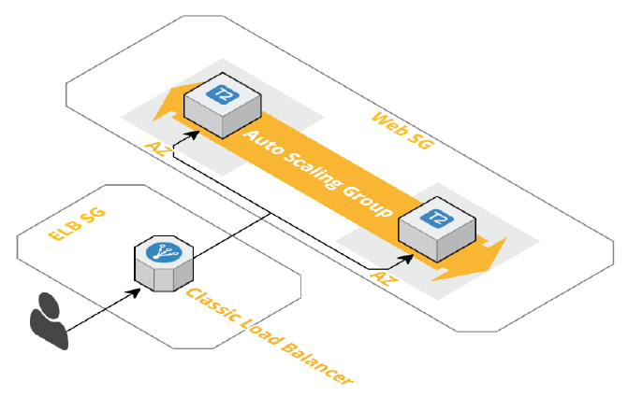
Auto Scaling Groups behind a Load Balancer
Auto Scaling helps you maintain application availability and allows you to scale your Amazon EC2 capacity up or down automatically according to the defined conditions. You can use Auto Scaling to help ensure that you are running your desired number of Amazon EC2 instances. Auto Scaling can also automatically increase the number of Amazon EC2 instances during demand spikes to maintain performance and decrease capacity during lulls to reduce costs. Auto Scaling is well suited to applications that have stable demand patterns, or that experience hourly, daily, or weekly variability in usage.
Elastic Load Balancing (ELB) allows the distribution of incoming traffic to your Amazon AWS infrastructure across multiple instances. This represents a great tool in avoiding failures in your applications and web traffic. ELB automatically detects failures in your EC2 instances and redirects traffic to other available instances.

Slide 8
Launching Auto Scaling Groups behind a Classic Load Balancer (Launch Configs)
We will create Classic Load Balancer to load balance the traffic to the instances that will be launched in the Auto Scaling group that we will also create. We will follow the security best practices by denying direct access for the EC2 instances by allowing requests coming only from the Load Balancer. To make sure that our application scales, we will configure some Scaling policies to scale the infrastructure up and down based on the usage. To do so, we will create a couple of CloudWatch Alarms to monitor a particular metric and trigger the scaling actions.
Topics for this effort:
Describe and launch EC2 instances
Understand and use user data scripts
Describe, create, and configure Security Groups
Describe and launch Classic Load Balancers
Describe and launch an Auto Scaling group
Basic Understanding of the CloudWatch service
OLD!

Slide 9
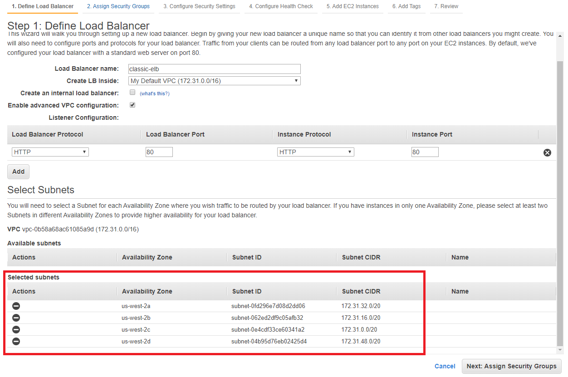
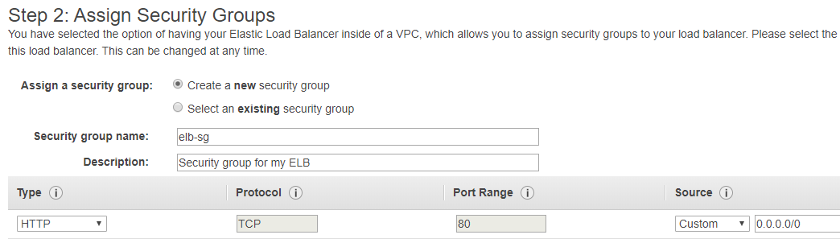
Launching Auto Scaling Groups behind a Classic Load Balancer
Log in to AWS and create an EC2 Classic Load Balancer
Give it a name
Enable advanced VPC configuration
Add some subnets
Next: Assign Security Groups
Create a new security group
Give it a name and description
Allow traffic from anywhere to TCP port 80
OLD!

Slide 10
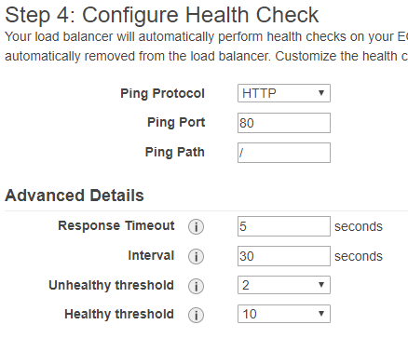
Launching Auto Scaling Groups behind a Classic Load Balancer
Configure LB Security Settings
Amazon displays a warning that our website is not using HTTPS/SSL – That is ok for today!
Next!
Configure Health Check
HTTP Ping Protocol, port 80
Ping Path: /
Advanced Details
Response Timeout: The amount of time to wait when receiving a response from the health check, in seconds. Valid values: 2 to 60. Default: 5
HealthCheck Interval: The amount of time between health checks of an individual instance, in seconds. Valid values: 5 to 300. Default: 30
Unhealthy Threshold: The number of consecutive failed health checks that must occur before declaring an EC2 instance unhealthy. Valid values: 2 to 10. Default: 2
Healthy Threshold: The number of consecutive successful health checks that must occur before declaring an EC2 instance healthy. Valid values: 2 to 10. Default: 10
OLD!

Slide 11
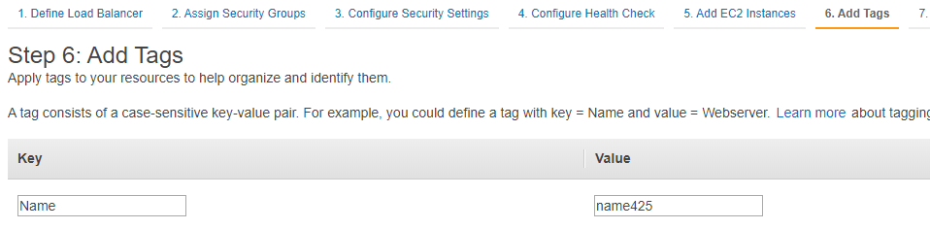
Launching Auto Scaling Groups behind a Classic Load Balancer
Add EC2 Instances... We don’t have any yet!
Two quick important notes:
Cross-Zone Load Balancing is used to ensure that your LB distributes requests evenly across all instances in its enabled Availability Zones. The LB will ignore the default of round-robin and will also take into consideration the AZ in which the instance is running. This reduces the need to maintain equivalent numbers of instances in each AZ and improves your ability to handle the loss of one or more instances.
Connection Draining is used to ensure that a Classic Load Balancer stops sending requests to instances that are de-registering or unhealthy while keeping the existing connections open.
Tags
Add a tag:
Key: Name
Value: name425
Review & Create!
OLD!

Slide 12
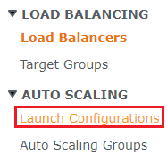
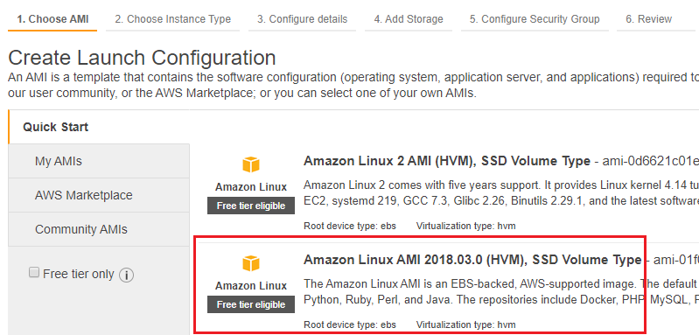
Create a Launch Configuration
Go to Launch Configurations!
Under Auto Scaling in EC2
Create a Launch Configuration!
Pick the Amazon Linux AMI (Not the Amazon Linux 2 AMI)
The code we use might not work with the Linux 2 AMI?
Amazon Linux AMI is not available to us anymore…
Use Amazon Linux 2 AMI
AMI ID: ami-089a545a9ed9893b6
Pick the Free Tier Eligible!
T2.micro instance type
1 vCPU/ 1GiB Memory
Low to Moderate network performance
OLD!

Slide 13
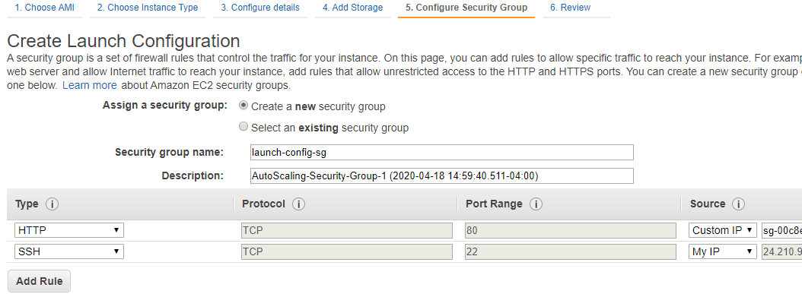
Create a Launch Configuration
Add Storage
Review configuration
8GiB disk, general purpose SSD, delete on termination
Configure Security Group
Create a new security group
Give it a name and description
Select the HTTP type
Pick the Custom IP source
Start typing “sg-” and select the custom SG for our ELB
Optionally add SSH from anywhere or from your IP only
Review & Create!
Keypair?!
OLD!

Slide 14
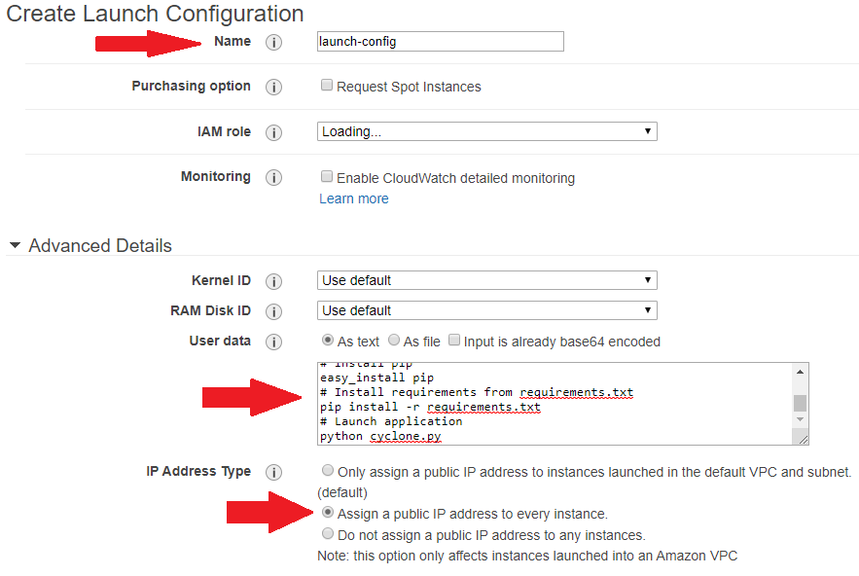
Create a Launch Configuration
Configuration Details
Enter a name for your Launch Config
Advanced Details…
Assign a public IP address to every instance!
User Data – This is where we can put commands to run when an instance is launched
#!/bin/bash
#Update system packages
yum update -y
#Install Git
yum install -y git
#Clone a repository
git clone https://github.com/cloudacademy/lab-utils.git
#Enter in the high_cpu folder - This is where the app lives
cd lab-utils/apps/high_cpu
# Install pip
easy_install pip
# Install requirements from requirements.txt
pip install -r requirements.txt
# Launch application
python cyclone.py
OLD!

Slide 15
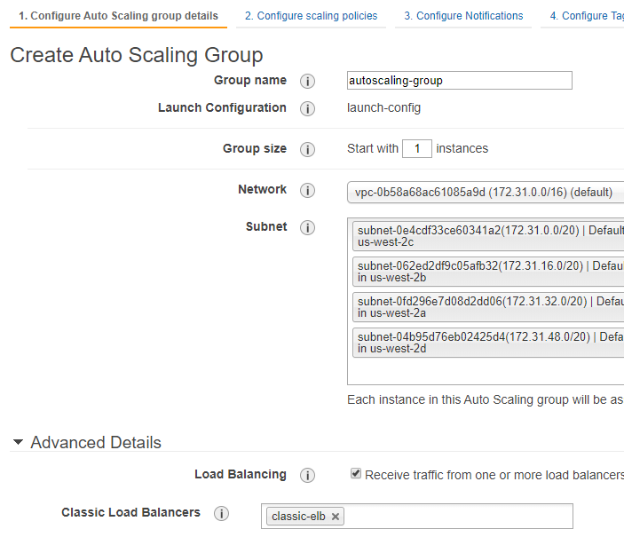
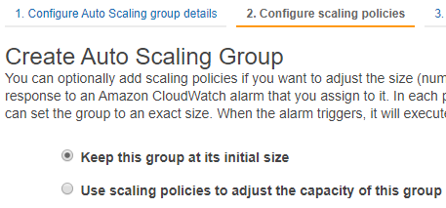
Create an Auto Scaling Group
Click the “Create an Auto Scaling Group using this Launch Configuration”
Give the ASG a name
Start with 3 Instances
Add all available subnets
Expand Advanced Details
Receive traffic from one or more LB’s
Choose the Classic Load Balancer we created earlier
Choose the ELB Health Check Type
300 second Health Check Grace Period
Configure Scaling Policies:
Keep this group at its initial size
Configure Notifications & Tag
We will skip…
Create!
OLD!

Slide 16
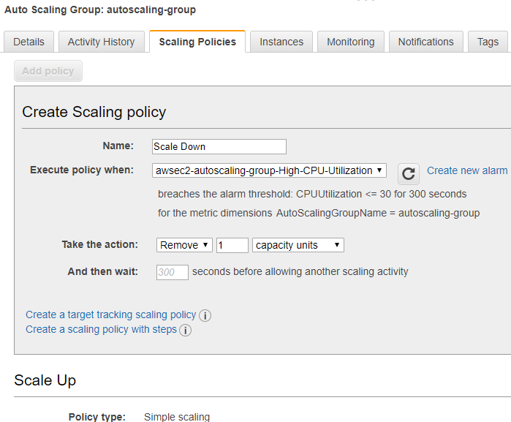
Create Scaling Policies
Go to Auto Scaling Groups
Select the ASG we just created
Click on the Scaling Policies tab
Add a policy:
Click Create a simple Scaling Policy
Name: Scale Up
Create a new alarm…
Uncheck the send a notification option
Set when average CPU is >= 70% for 1 period of 5 minutes
Take the action to Add 1 capacity unit
Create!
Add another policy:
Simple scaling policy – Scale Down – Create a new alarm…
Whenever CPU average is <= 30% for 1 period of 5 minutes
Remove one capacity unit!
OLD!

Slide 17
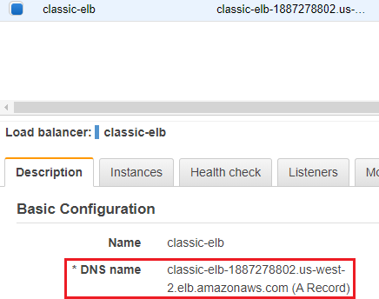
Create Scaling Policies
Click the Details tab and edit on the Launch Configuration, so we can change our scaling!
Desired Capacity: 3
Min: 2
Max: 4
Open the load balancer and copy the DNS name
Visit the website
Launch the “burn baby burn” page
Hit refresh a few times to get all instances
Watch additional instances startup
Takes 5 minutes…
Reduce the CPU usage
Watch instances terminate
Takes 5 minutes…
OLD!

Slide 18
Launch Templates
Launch templates can be used to automate instance launches, simplify permission policies, and enforce best practices. Save launch parameters in a template that can be used for on-demand launches and with managed services, including EC2 Auto Scaling and EC2 Fleet. Easily update your launch parameters by creating a new launch template version.
Launch Templates can minimize steps needed to provision instances. With EC2 Auto Scaling, updates to a launch template can be automatically passed to an Auto Scaling group.
Topics for this effort:
Describe and launch EC2 instances from launch templates
Understand and use user data scripts with launch templates
Describe, create, and configure Security Groups
Describe and launch Load Balancers
Describe and launch an Auto Scaling group
Basic Understanding of the CloudWatch service

Slide 19
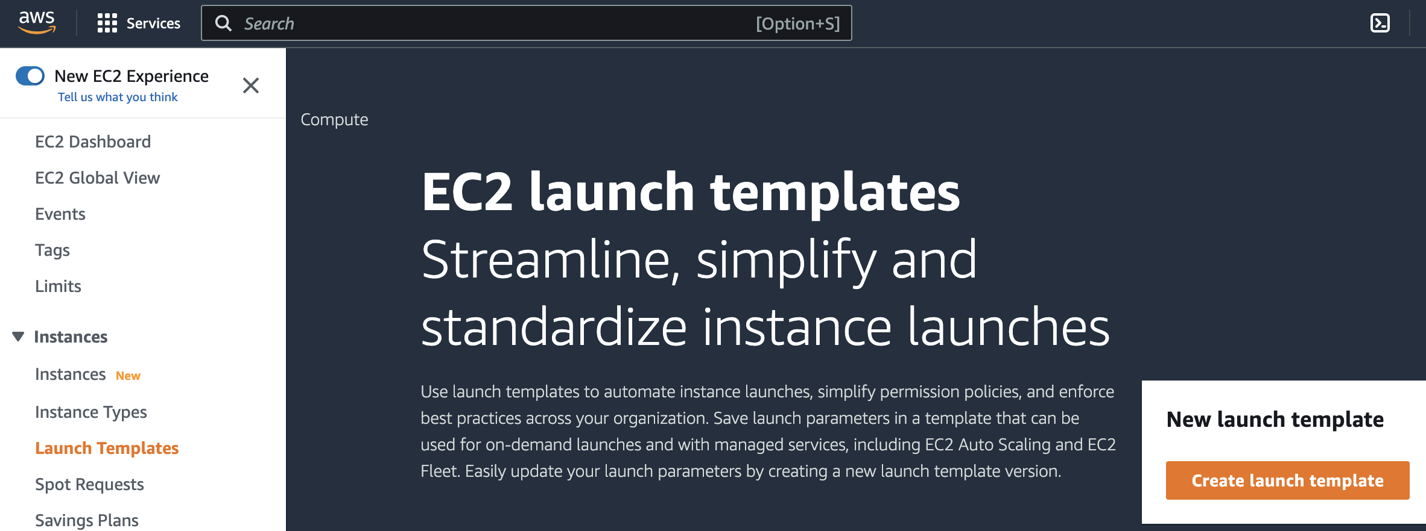
Launch Templates
Lets create a launch template!
We should already have a key pair created and subnets in our desired Availability Zones for use

Slide 20
Launch Templates
Launch Template Name: MyLaunchTemplate
Auto Scaling Guidance: Yes (checked)
This will provide some guidance for us to use our template with auto scaling
Application and OS Images (AMI)
Quick Start
Amazon Linux 2023 kernel-6.1 AMI (HVM) 64-bit (x86)
Instance Type
t3.micro – 1vCPU, 1GB RAM (free tier eligible)
Key Pair Login
Using my existing key pair login, previously created
You can optionally create a new key pair at this point

Slide 21
Launch Templates
Subnet: Don’t include in launch template
Since we want to use our launch template with EC2 Auto Scaling, we won’t include it here
Security Group: Create a new Security Group
If we had an existing security group that met our needs, we could use it here
Name: MyWebServerSG
Description: Web Server Access
Default VPC
Add Inbound Security Group Rules
SSH access from anywhere
HTTP access from anywhere
Storage: Default EBS 8GB disk
General Purpose SSD disk (gp3) 3000 iops

Slide 22
Launch Templates
Advanced Details
Many different options available…
User Data
#!/bin/bash
#Install Git & pip
dnf install -y git pip
#Clone a repository
git clone https://github.com/cloudacademy/lab-utils.git
#Enter in the high_cpu folder - This is where the app lives
cd lab-utils/apps/high_cpu
# Install requirements from requirements.txt
pip install -r requirements.txt
# Launch application
python3 cyclone.py
Create Launch Template!

Slide 23
Launch Template Updates
Advanced Details
User Data
#!/bin/bash
#Update system packages
dnf upgrade --releasever=latest -y
dnf update -y
#Install Git & pip
dnf install git pip -y
#Clone a repository
git clone https://github.com/cloudacademy/lab-utils.git
#Enter in the high_cpu folder - This is where the app lives
cd lab-utils/apps/high_cpu
# Install requirements from requirements.txt
pip install -r requirements.txt
# Launch application on reboot
echo "#!/bin/bash" > /etc/rc.d/rc.local
echo "cd /lab-utils/apps/high_cpu && python3 cyclone.py" >> /etc/rc.d/rc.local
chmod 750 /etc/rc.d/rc.local
systemctl enable rc-local
# Reboot
reboot
Make sure to update the default template version!

Slide 24
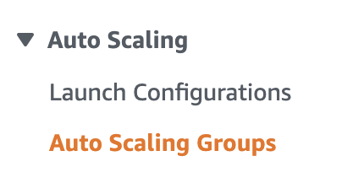
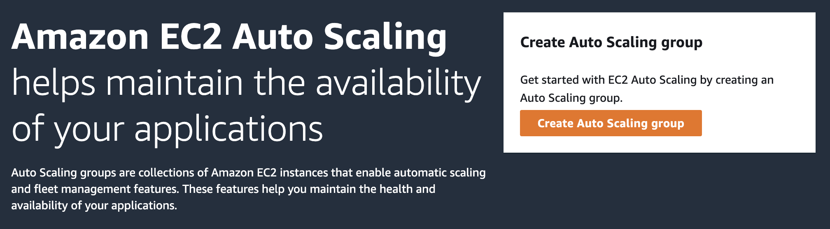
Auto Scaling Groups
EC2 Auto Scaling helps you maintain application availability and allows you to scale capacity up or down automatically according to your conditions. You can use Auto Scaling to help ensure that you are running your desired number of Amazon EC2 instances during demand spikes to maintain performance and decrease capacity during lulls to reduce costs.
Create an Auto Scaling Group!

Slide 25
Auto Scaling Groups
Name: MyASG
Launch Template: MyLaunchTemplate
This is the launch template we just created!
Next!
Network: Default VPC
Select each available AZ/subnet
Next!
Load Balancing: Attach to a new Load Balancer
Application Load Balancer
Internet Facing
Listeners and Routing: Port 80, Create a new target group
Next!

Slide 26
Auto Scaling Groups
Group Size
Desired Capacity: 1
Minimum Capacity: 0
Maximum Capacity: 3
Scaling Policy: Target tracking scaling policy
Average CPU utilization
Target Value: 50
300 Second warm-up!
Next!
Optionally add notifications or tags
Review and Create!
A new instance will be created!!!

Slide 27
Auto Scaling Groups
Find the IP address of your EC2 instance and browse to it in your web browser
You can also use the URL of the load balancer…
Click the “burn baby burn” link and watch what happens
A large CPU load is put on the instance
The ASG will see the increased CPU usage and launch a new instance
This might take a few minutes (5-10?), based on monitoring settings and such
Click the “relax” link
Eventually CPU usage will drop and the extra instances will be terminated
Make sure to delete anything created during this exercise!
You will be charged for resources left running!
EC2 instances, IP addresses, disk allocations…

Slide 28
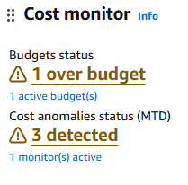
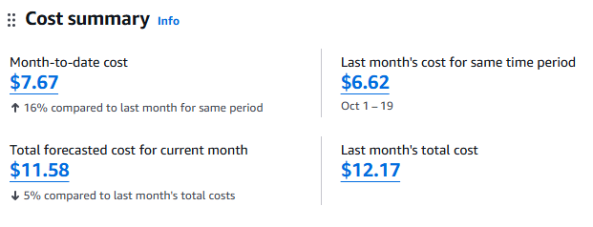
Billing and cost management
Cost Summary
Month to date Cost
Forecasted costs
Last month’s costs
Cost monitor
Budgets
Anomalies
Alerts
Current costs
Projected costs
FinOPS!

Slide 29
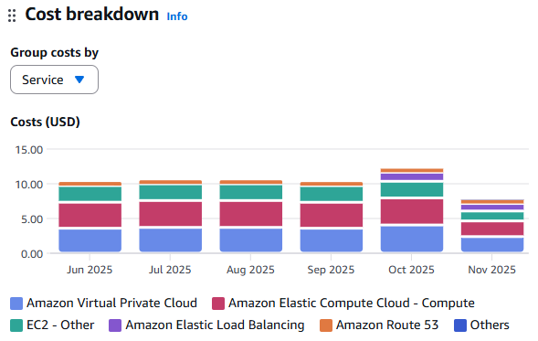
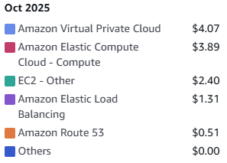
Billing and cost management
Cost Breakdown
Service
Region
Tags
Detailed costs

Slide 30
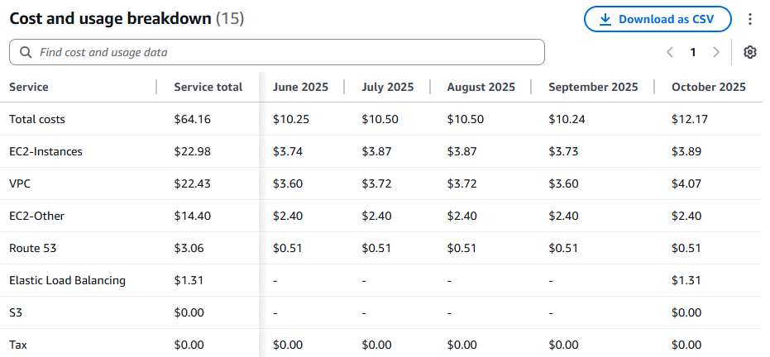
Billing and cost management
Cost Explorer – Cost and usage report
Breakdown of bills
Filter by date, service, region, types, etc.
Comparison graphs
Difference breakdowns
Cost Anomaly Detection
Detected Anomalies
Cost impact
Comparisons
Custom Dashboards

Slide 31
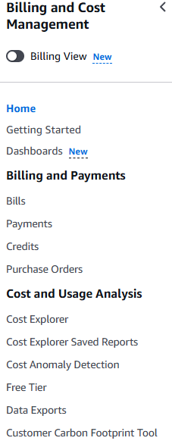
Billing and cost management
Billing and Payments
Credits
Cost Organization
Cost Allocation
Budgets & Reports
Savings Plans
Reservations
Trends
More!

Slide 32
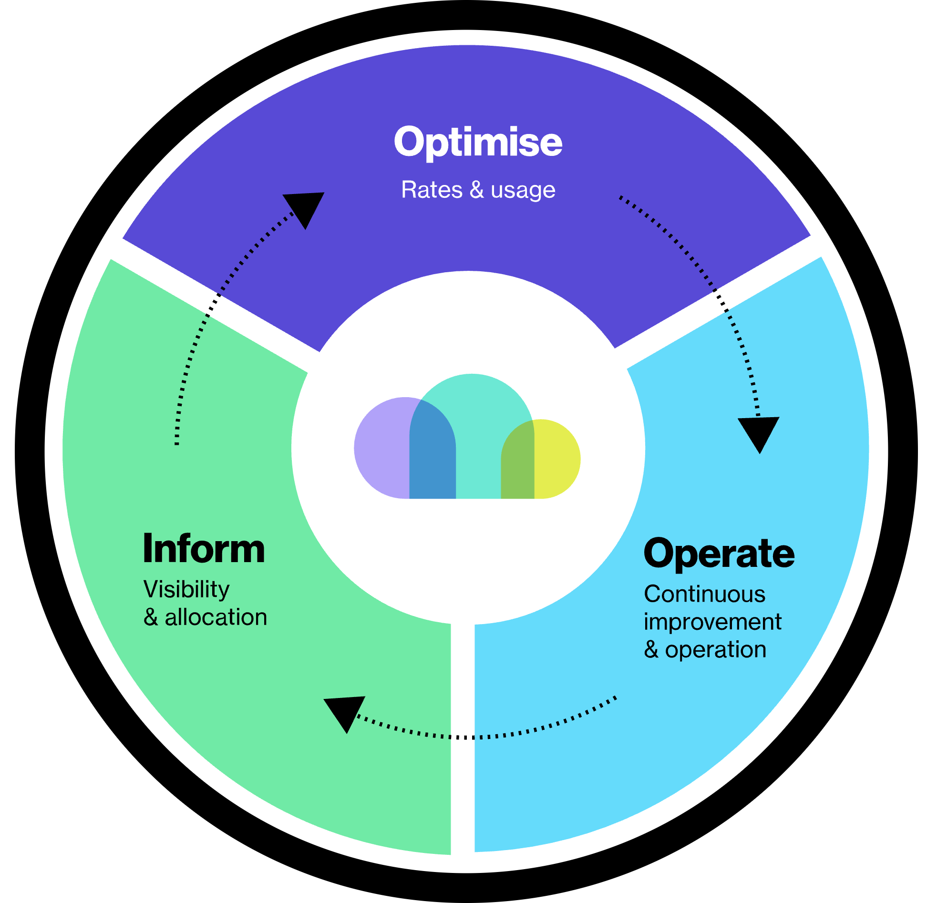
Financial Operations - FinOPS!
A financial operations framework for managing cloud costs and maximizing business value.
Engineering, finance, and business teams work together to create financial accountability
Data-driven decisions
Improvement through iteration
Continuously improve cloud usage and cost efficiency
Inform: Focus on gathering and visualizing cost data to build visibility and understanding.
Optimize: Identify and implement cost-saving opportunities based on the information gathered in the Inform phase.
Operate: Implement and automate changes, continuously monitor them, and return to the Inform phase to report the results.

Slide 33
CMAC 3990.200 Systems Administration and Operations
Fall 2025 – Week 13.2 – November 20th, 2025
Cloud – Simple Storage Services and Lambda

Slide 34
Amazon Web Services
EC2 – Elastic Compute Cloud – The Amazon Web Services component
Instance – Virtual Machine – A running VM, similar to our class VM’s
Amazon Machine Image (AMI) – Template – An OS installed and pre-configured to quickly deploy
Virtual Private Cloud (VPC) – Network – A virtual private non-routable network subnet
Internet Gateway (IGW) – Gateway/router – Next hop to the internet
Region – A generalized location where AWS physical services are located
Availability Zone – An individual data center within a region
Security Group – A virtual firewall
Elastic Load Balancer (ELB) – The Elastic Load Balancing Service from Amazon will automatically distribute incoming application traffic across multiple Amazon EC2 instances.
Load balancers allow you to achieve fault tolerance in your applications, seamlessly providing the required amount of load balancing capacity needed to route application traffic.

Slide 35
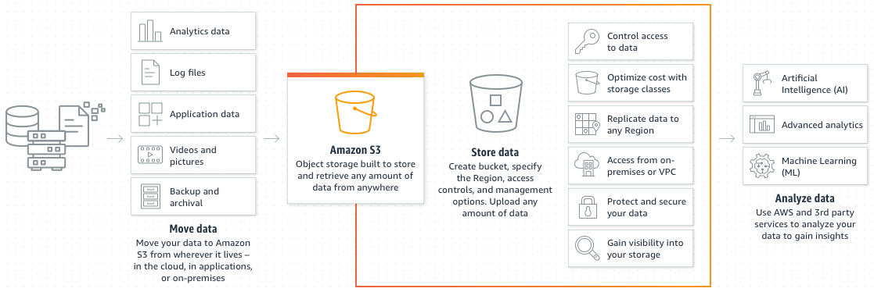
Amazon Simple Storage Services
S3 – Simple Storage Services – An object storage service offering scalability, security, availability, and performance, with up to 99.999999999% (eleven 9’s) of availability.
S3 Glacier – Data Archiving Solutions with different tiers for instant retrieval, flexible retrieval (minutes to hours), or deep archive retrieval (5-12 hours).
Near Line Storage – Intermediate type of data storage that is not immediately available, but can be made online quickly without human intervention.

Slide 36
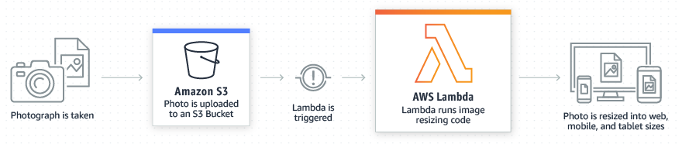
Amazon Web Services Lambda
Lambda is a serverless, event-driven compute service that lets you run code for virtually any type of application or backend service without provisioning or managing servers.
Build event-driven functions for easy communication between decoupled services. Reduce costs by running applications during times of peak demand without crashing or over-provisioning resources.

Slide 37
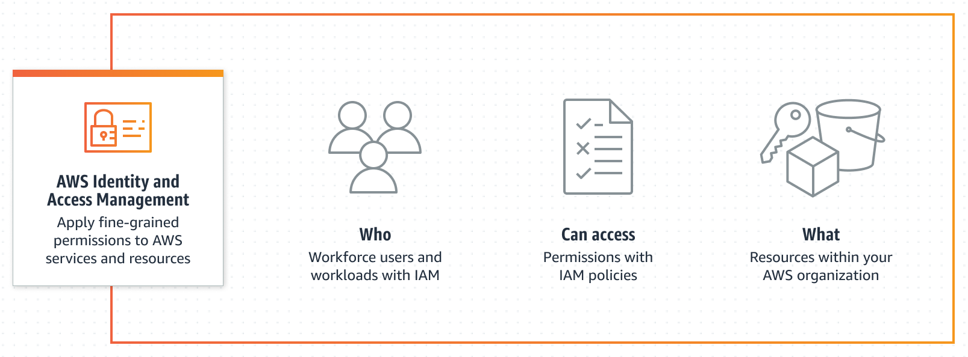
AWS Identity & Access Management (IAM)
Identity and Access Management (IAM) allows you to apply fine-grained access controls
Access controls based on department, title, job role, team name, etc.
Establish permission guardrails for IAM users and/or roles
Manage per-account IAM identities
Set, verify, and right-size permissions toward principles of least privilege

Slide 38

Amazon Web Services S3
Navigate to the AWS S3 Console and create a new General purpose storage bucket
Bucket Name: my3990bucket (no spaces or uppercase letters!)
Region: US-East-2 (Ohio)
Your Lambda function must be in the same region!
Access Control Lists Disabled
You can enable ACL’s to allow access to other AWS accounts
Block Public Access to Bucket
You could optionally allow different levels of direct access to the bucket and objects
Bucket Versioning Disabled
Keep old versions of items when items are changed
Optionally add Tags or enable Server-Side Encryption
Object Lock – Disable
Write once read many (WORM), prevent items from being deleted or overwritten, requires versioning
Create Bucket!
Notes:
Adapted from https://docs.amazonaws.cn/en_us/lambda/latest/dg/with-s3-example.html

Slide 39
Amazon Web Services S3
Upload a test image to your new bucket
Make sure things work as expected!
Make sure you understand uploading objects through the GUI console
Open the newly created bucket and select Upload from the Objects tab
Drag & Drop or browse for files
Optionally create folders for organization
Optionally adjust other settings for encryption, versioning, or others
Make sure to hit the orange Upload button after adding your file!
Example file uploaded: dogpic1.jpg
https://jpatalon.cs.edinboro.edu/cmac3990/dogpic1.jpg
Click the new bucket object to see the details
S3 Uniform Resource Identifier (URI), Amazon Resource Name (ARN), Object URL
Browse to the Object URL to make sure it works!
Direct access is blocked - no permissions!
Click the “Open →” button to open within your account

Slide 40

Amazon Web Services Lambda
Navigate to the AWS Lambda console and create a new function
Select Use a Blueprint to create our new function
Search for and select the blueprint “s3-get-object-python”
There are many other blueprints available for other usages
Give your function a name: my-3990-s3-function
Select Create a new role from Amazon policy templates for the execution role
Give the role a name: my-3990-s3-function-role
Under S3 trigger choose the bucket we created earlier
Optional event types: PUT, POST, Copy, Delete, etc.
Optional prefixes or suffixes to limit actions to specific directories, file names, or file types
Acknowledge the recursive invocation warning
Review the Lambda code to see what it is doing
Create Function!

Slide 41
Amazon Web Services Lambda
Test our new function in the Lambda console
Within our new Lambda function, on the Code tab, click the Test button
Select Create new test event from the drop down menu
Give the event a name: my3990s3testevent
For Event Template choose S3 Put (s3-put)
In the JSON replace the S3 Bucket name with your bucket name!
Lines 23 & 27
Replace the object key with your uploaded file name (ex: dogpic1.jpg)
Line 30
Save!
Invoke the test
Under Code Source in the test event, click Test
The execution results output will open, displaying the log of the function

Slide 42
Amazon Web Services Lambda
Test our new function by uploading a new image to our S3 bucket
Return to our bucket and upload a new picture or two
https://jpatalon.cs.edinboro.edu/cmac3990/dogpic2.jpg
https://jpatalon.cs.edinboro.edu/cmac3990/dogpic3.jpg
Go back to the Lambda console and select our Lambda function
Select the Monitor tab of our Lambda function
Check that we have new invocations, matching the number of files we just uploaded
2 files uploaded = 2 invocations!
Don’t forget to cleanup and delete when we are done!
Lambda Function
IAM Policies (2)
IAM Execution Role
Empty & delete S3 Bucket
This lambda function just displays the Content Type (image/jpeg) in the logs
Let’s try something more exciting!

Slide 43
Amazon Web Services S3 part duex
Navigate to the AWS S3 Console and create two new storage buckets
my3990bucketsource
my3990bucketsource-resized
Use all default bucket settings
Make sure both buckets are in the same region!
US-East-2 Ohio
Upload an image to our new source bucket my3990bucketsource
We need a sample object in our bucket before we will be able to test our Lambda function
dogpic1.jpg ?!
https://jpatalon.cs.edinboro.edu/cmac3990/dogpic1.jpg
Notes:
Adapted from https://docs.amazonaws.cn/en_us/lambda/latest/dg/with-s3-tutorial.html

Slide 44

Amazon Web Services IAM Policy
Navigate to the AWS IAM Policies Page and create a new policy
Select the JSON tab and put in the following policy:
{
"Version": "2012-10-17",
"Statement": [
{
"Effect": "Allow",
"Action": [
"logs:PutLogEvents",
"logs:CreateLogGroup",
"logs:CreateLogStream"
],
"Resource": "arn:aws:logs:*:*:*"
},
{
"Effect": "Allow",
"Action": [
"s3:GetObject"
],
"Resource": "arn:aws:s3:::my3990bucketsource/*"
},
{
"Effect": "Allow",
"Action": [
"s3:PutObject"
],
"Resource": "arn:aws:s3:::my3990bucketsource-resized/*"
}
]
}
Name: AWS3990LambdaS3Policy
Make sure to use the correct resource bucket names!

Slide 45
Amazon Web Services IAM Execution Role
Navigate to the AWS IAM Roles Page and create a new role
Trusted Entity Type: AWS Service
Use case: Lambda
Permissions Policy: Customer managed: AWS3990LambdaS3Policy
This is the IAM policy we just created
Role Name: lambda-3990-s3-role
Create Role!
Install the AWSv2 CLI (on your EUP VM):
dnf -y install zip unzip
curl "https://awscli.amazonaws.com/awscli-exe-linux-x86_64.zip" -o "awscliv2.zip"
unzip awscliv2.zip
./aws/install
ln -s /usr/local/bin/aws /bin/aws

Slide 46
Amazon Web Services Lambda part duex
Create a Lambda deployment package
Deployment packages are .zip file archives that contain your Lambda function code and any dependencies
Open a CLI environment to complete the following tasks (1/2)
Make a directory called lambda-s3 and change into it
mkdir lambda-s3
cd lambda-s3
Save the function code linked below as index.js
wget https://jpatalon.cs.edinboro.edu/cmac3990/index.mjs.txt -O index.mjs
Create a directory called node_modules and change into it
mkdir node_modules
cd node_modules
Install nodejs repo and NPM prerequisites
dnf -y module enable nodejs:20
dnf -y install nodejs zip unzip

Slide 47
Amazon Web Services Lambda part duex
Create a Lambda deployment package
Deployment packages are .zip file archives that contain your Lambda function code and any dependencies
Open a CLI environment to complete the following tasks (2/2)
Use NPM to install sharp from within the node_modules directory
npm install sharp aws-sdk
Change back to lambda-s3 directory and create a zip file with the recursive zip option
cd ..
zip -r function.zip .
Configure your AWS cli environment
aws configure
Access Key ID: AKIA46R…
Secret Access Key: HT60owMBco…
Default Region Name: us-east-2
Default Output Format: json

Slide 48
Amazon Web Services Lambda part duex
Create a new Lambda function in AWS from the cli
aws lambda create-function --function-name CreateThumbnail \
--zip-file fileb://function.zip --handler index.handler \
--runtime nodejs20.x --timeout 10 --memory-size 1024 \
--role arn:aws:iam::890211387967:role/lambda-3990-s3-role
Test the Lambda function from the CLI
Download the inputFile.txt sample event data in the same lambda-s3 project directory
wget https://jpatalon.cs.edinboro.edu/cmac3990/inputFile.txt
Make sure to edit the file and change the region, bucket, and image names to be correct!
awsRegion, bucket name, bucket arn, object key
Invoke the function with the following aws command:
aws lambda invoke --function-name CreateThumbnail \
--cli-binary-format raw-in-base64-out --invocation-type Event \
--payload file://inputFile.txt outputfile.txt
Notes:
Note the account ID in bold/underline!

Slide 49
Amazon Web Services Lambda part duex
Check that we now have a thumbnail in our resized S3 bucket!!
Browse to the my3990bucketsource-resized S3 bucket and look at the objects
Success!
Configure S3 to publish events
This will add permissions to allow S3 to publish object-created events to Lambda and invoke the Lambda function…
Replace the source-account ID with your account ID!
aws lambda add-permission --function-name CreateThumbnail \
--principal s3.amazonaws.com --statement-id s3invoke \
--action "lambda:InvokeFunction" --source-arn arn:aws:s3:::my3990bucketsource \
--source-account 890211387967
Verify the function’s access policy with the following command:
aws lambda get-policy --function-name CreateThumbnail

Slide 50
Amazon Web Services Lambda part duex
Configure notifications on the S3 bucket.
To have Amazon S3 publish object-created events to Lambda, add a notification configuration on the source S3 bucket.
Browse to the source bucket in the AWS GUI Console
Choose the properties tab
Scroll down to Amazon Eventbridge, click edit, and turn on EventBridge notifications
Scroll down to Event Notifications and Create Event Notification with the following:
Event name – lambda-trigger
Event types – All object create events
Destination – Lambda function
Lambda function – CreateThumbnail
Verify
Upload some new images to the S3 bucket and see if thumbnails are generated
Dogpic2 & dogpic3!

Slide 51
Amazon Web Services
Cleanup!
S3 Buckets
my3990bucketsource
my3990bucketsource-resized
Lambda Function
CreateThumbnail
IAM Policy
AWS3990LambdaS3Policy
IAM Execution Role
lambda-3990-s3-role

Slide 52
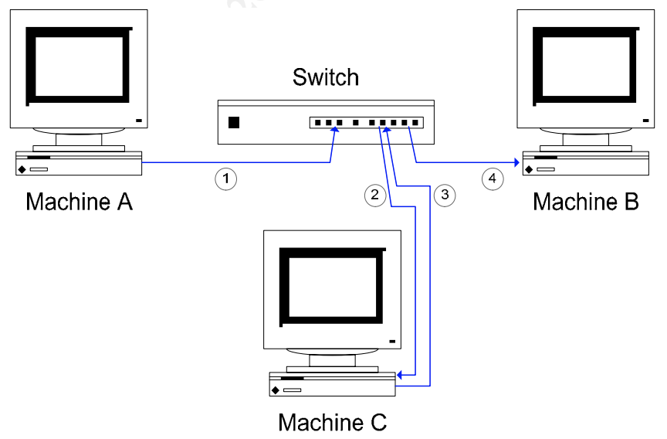
Man in the Middle Attack
Packet Sniffing in a switched environment
https://jpatalon.cs.edinboro.edu/cmac3990/packet-sniffing-switched-environment-244.pdf
MAC flooding, MAC duplicating, ICMP redirection, DHCP spoofing, Port stealing
ARP Spoofing
Taking the example of machines A, B, and C.
Assume C wanted to eavesdrop on network traffic between A and B.
For a man–in-the-middle attack, C pretends to A that it is in fact B.
Then, when A sends traffic destined for B, it is intercepted by C.
C passes this information on to B, pretending that it came from A.
Similarly, C also performs a comparable role for traffic from B, which is destined for A

Slide 53
Man in the Middle Attack
Packet Sniffing in a switched environment
https://jpatalon.cs.edinboro.edu/cmac3990/packet-sniffing-switched-environment-244.pdf
MAC flooding, MAC duplicating, ICMP redirection, DHCP spoofing, Port stealing
ARP Spoofing
The first step is for C to pretend to A that it is in fact B.
If this can be achieved, network traffic destined for B will be routed to C.
Likewise, C must pretend to B that it is in fact A.
How can this be achieved? C “poisons” the ARP cache on A and B.
ARP is a stateless protocol that does not require authentication, so a simple ARP replay packet sent to each host will force an update in their ARP cache.
C sends a spoofed ARP packet to A, instructing A to send packets destined for B to C.
The spoofed ARP packet C sends forces A to update its own ARP cache.
In A’s updated ARP cache, B’s IP address maps to C’s MAC address.
This means future communication from A which is destined for B will go via C.

Slide 54
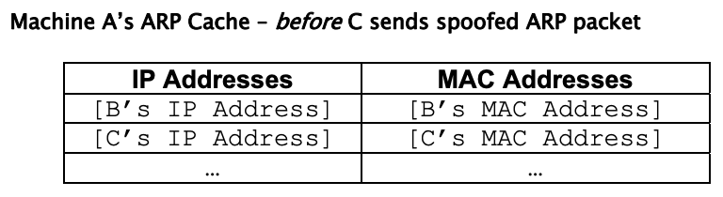
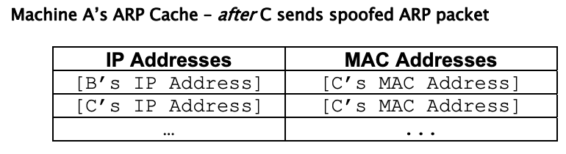
Man in the Middle Attack
Packet Sniffing in a switched environment
https://jpatalon.cs.edinboro.edu/cmac3990/packet-sniffing-switched-environment-244.pdf
MAC flooding, MAC duplicating, ICMP redirection, DHCP spoofing, Port stealing
ARP Spoofing
C also does something similar to B.
It sends a spoofed ARP packet to B, instructing B to update its ARP cache so that A’s IP address maps to C’s MAC address.
Once this has been done, packets that A attempts to send to B are routed to C. Packets that B attempts to send to A are routed to C as well.

Slide 55
Man in the Middle Attack
Packet Sniffing in a switched environment
https://jpatalon.cs.edinboro.edu/cmac3990/packet-sniffing-switched-environment-244.pdf
MAC flooding, MAC duplicating, ICMP redirection, DHCP spoofing, Port stealing
ARP Spoofing
There is one more important step. Machine C also has to ensure that traffic it receives is sent on to its true destination.
So, for example, when A sends traffic destined for B, it is intercepted by C, but sent on from C to B. This can easily be achieved by IP forwarding in many OS’s.
Alternatively, an application can take responsibility for forwarding the traffic to its true destination.
Once a spoofed ARP packet has been sent to a target machine, the attacker will need to re-send this information on a regular basis, to “re-poison” the ARP cache.
This is because operating systems automatically refresh ARP caches on a frequent basis (every 30 seconds is a typical refresh rate).

Slide 56
Man in the Middle Attack
Packet Sniffing in a switched environment
https://jpatalon.cs.edinboro.edu/cmac3990/packet-sniffing-switched-environment-244.pdf
MAC flooding, MAC duplicating, ICMP redirection, DHCP spoofing, Port stealing
ARP Spoofing
An interesting side-effect is made possible through eavesdropping by ARP spoofing/ IP forwarding.
Because we are performing a man–in-the-middle attack, we can alter (add, modify or delete) packets we intercept, or even create new packets.
This enables us to hijack certain types of sessions, telnet, for example.
In addition to sniffing the telnet traffic, we can forge commands made by the client, or replies made by the server.
This enables all sorts of nefarious activities
Forging commands to send password files or other things to the attacker
Session hijacking is not just a theoretical possibility.
Tools such as ettercap and hunt make it simple to achieve.

Slide 57
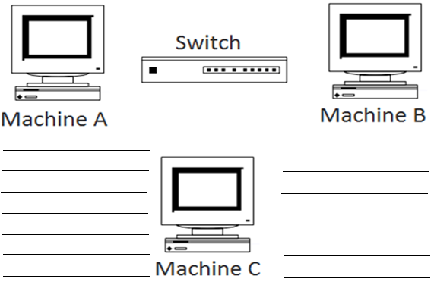
Man in the Middle Attack
Switched Network

Slide 58
Physical Disk and Volume
Look at this new device we have, /dev/vdb
fdisk –l /dev/vdb
Disk /dev/vdb: 21.5 GB, 21474836480 bytes, 41943040 sectors
We’re not going to do anything with /dev/vdb today…
Maybe in the future? Bonus Assignment? Final hands-on? I don’t know!
Create new ?GB partition, PV, VG
Create new ?GB LVM → Format filesystem and mount
Add ? GB to existing centos VG
Add ?GB to Swap LVM → Increase swap filesystem
Add ?GB to Root LVM → Increase root filesystem
Future?

Slide 59
Disks, Volume Groups, and Logical Volumes
Disk: /dev/vdb
[root@cmac3990-110 ~]# fdisk -l /dev/vdb
Disk /dev/vdb: 21.5 GB, 21474836480 bytes, 41943040 sectors
Units = sectors of 1 * 512 = 512 bytes
Sector size (logical/physical): 512 bytes / 512 bytes
I/O size (minimum/optimal): 512 bytes / 512 bytes
SDB 21.5GB 0 partitions!
Future?

Slide 60

Disks, Volume Groups, and Logical Volumes
Create a new 1GB partition on disk /dev/vdb:
[root@ecsc425-110 ~]# fdisk /dev/vdb Command (m for help): n Partition type: p primary (0 primary, 0 extended, 4 free) e extended Select (default p): p Partition number (1-4, default 1): First sector (2048-41943039, default 2048): Using default value 2048 Last sector, +sectors or +size{K,M,G} (2048-41943039, default 41943039): +1G Partition 1 of type Linux and of size 1 GiB is set Command (m for help): t Selected partition 1 Hex code (type L to list all codes): 8e Changed type of partition 'Linux' to 'Linux LVM'
Command (m for help): w The partition table has been altered!
Calling ioctl() to re-read partition table. Syncing disks.
Future?

Slide 61
Disks, Volume Groups, and Logical Volumes
Mark new vdb1 partition as a Physical Volume, create a new Volume Group vg_a15, create a new Logical Volume lv_a15, format with xfs file system
[root@ecsc425-110 ~]# pvcreate /dev/vdb1 Physical volume "/dev/vdb1" successfully created.
[root@ecsc425-109 ~]# vgcreate vg_a15 /dev/vdb1 Volume group "vg_a15" successfully created
[root@ecsc425-109 ~]# lvcreate -n lv_a15 -l 100%FREE vg_a15 Logical volume "lv_a15" created.
[root@ecsc425-109 ~]# mkfs.xfs /dev/vg_a15/lv_a15 meta-data=/dev/vg_a15/lv_a15 isize=512 agcount=4, agsize=65280 blks = sectsz=512 attr=2, projid32bit=1 = crc=1 finobt=0, sparse=0 data = bsize=4096 blocks=261120, imaxpct=25 = sunit=0 swidth=0 blks naming =version 2 bsize=4096 ascii-ci=0 ftype=1 log =internal log bsize=4096 blocks=855, version=2 = sectsz=512 sunit=0 blks, lazy-count=1 realtime =none extsz=4096 blocks=0, rtextents=0
Future?

Slide 62
Disks, Volume Groups, and Logical Volumes
Persistently mount our new LV at /a15
[root@ecsc425-109 ~]# df -h /dev/vg_a15/lv_a15 Filesystem Size Used Avail Use% Mounted on devtmpfs 1.9G 0 1.9G 0% /dev
[root@ecsc425-109 ~]# mkdir /a15
[root@ecsc425-109 ~]# df -h /a15 Filesystem Size Used Avail Use% Mounted on /dev/mapper/centos-root 26G 8.2G 18G 32% /
[root@ecsc425-109 ~]# echo "/dev/mapper/vg_a15-lv_a15 /a15 xfs defaults 0 0” >> /etc/fstab
[root@ecsc425-109 ~]# mount -a
[root@ecsc425-109 ~]# df -h /a15 Filesystem Size Used Avail Use% Mounted on /dev/mapper/vg_a15-lv_a15 1017M 33M 985M 4% /a15
Future?

Slide 63
Other example tasks
Add new DNS records
Identify DNS issues for a specified domain
Troubleshoot mail server DNS issues
Complete a DNS hierarchy tree
Add a VLAN network interface (IPv4 and IPv6)
MITM example and explanation
Future?

Slide 64
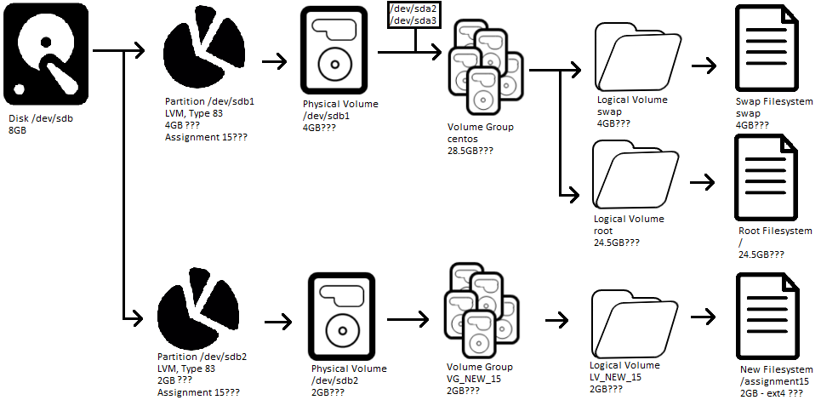
Disks, Volume Groups, and Logical Volumes
Disk:
/dev/vdb
Future?

Slide 65
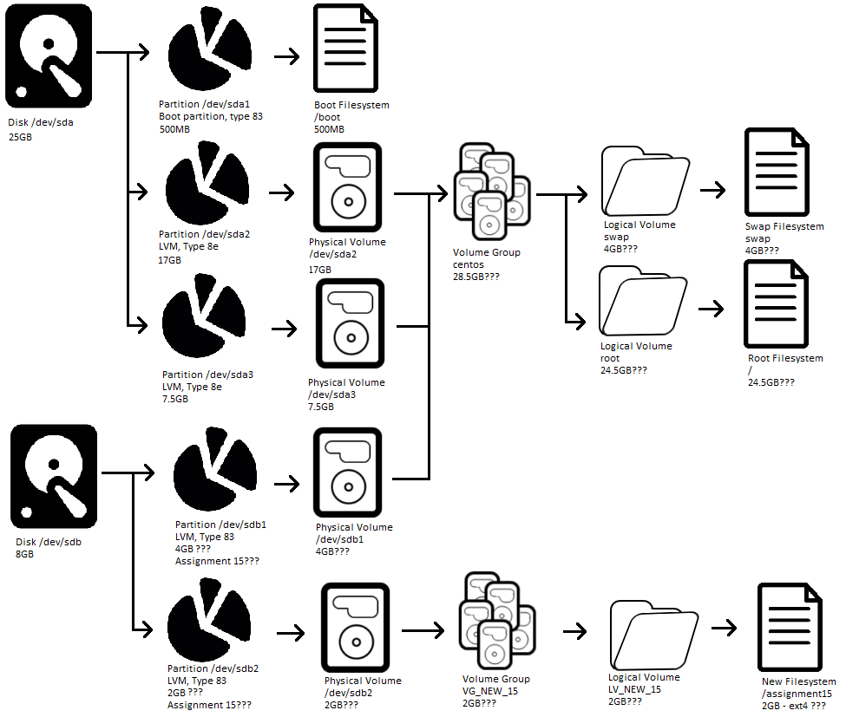
Disks, Volume Groups, and Logical Volumes
Disks: /dev/vda and /dev/vdb
Future?

Slide 66

Lessons Learned
Consistency? Clarity?
Expectation vs. reality?
Opportunities for improvement?
Better combined with 325 related topics
Remove duplicate discussions/info
More cloud? Better organized?
Another week of content
We cancelled one class, some classes were short…
Move VMs to cloud
Review all IP addresses for consistency!
Version numbers on assignments to match scripts?
3 digit student numbers?

Slide 67

Assignments 11-13, AWS
Assignment 11 – 63 points – Due November 14th, 2025
Survey and Questionnaire
https://jpatalon.cs.edinboro.edu/cmac3990/Assignment%2011.pdf
Assignment 12 – 72 points – Due November 21st, 2025
Network updates, Switch to Docker-CE, OwnCloud vs. NextCloud, Disk updates
https://jpatalon.cs.edinboro.edu/cmac3990/Assignment%2012.pdf
Assignment 13 – 65 points – Due December 5th, 2025
Final additional/related tasks – good for review…
https://jpatalon.cs.edinboro.edu/cmac3990/Assignment%2013.pdf
Assignment AWS – 50 points bonus – Due December 5th, 2025
AWS CLI deployment
https://jpatalon.cs.edinboro.edu/cmac3990/Assignment%20AWS.pdf

Slide 68
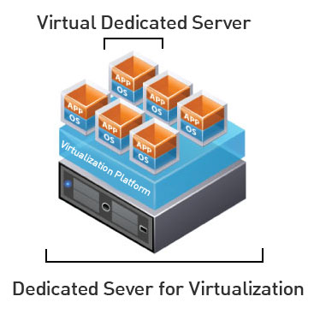
Virtual Machines
VM Info:
IP Address: 147.64.243.1##/23 (01-20) – bond0
Hostname: cmac3990-1##.cs.edinboro.edu (01-20)
Alias: 41##.megastuff.biz (01-20)
Samba: \\147.64.243.1##\ (01-20)
Interfaces:
Enp1s0, enp8s0, enp9s0, enp10s0, mybond0, mybond0.6, mybond0.110, mybond0.187
IP’s
mybond0 – 147.64.243.1## & 147.64.243.150+##/23
mybond0.6 – fd06:1234:5678:beef:1##::1/64
mybond0.110 – 10.10.1##.1/16
mybond0.187 – 10.1.187.1##/22
Additional IP’s…
mybond1 – 192.168.1.1##/24 & 192.168.1.2##/24 & fd06:8765:4321:face:1##::1/64
mybond1.399 – 192.168.1##.25/19
mybond1.222 – 10.222.222.2##/22

Slide 69
Virtual Machines
IP Address: 147.64.243.1## (01-15)
Hostname: cmac3990-1##.cs.edinboro.edu (01-15)
Alias (01-15):
##.megastuff.biz
1##.megastuff.biz
41##.megastuff.biz (subdomain)
SOA, NS, A, MX
www, ipv6, newprivate1, private2, midterm1-4?
Nextcloud.1##.megastuff.biz
Owncloud.1##.megastuff.biz
We didn’t really use these aliases

Slide 70
Linux Commands
nmap
ping
mkdir
rsync
crontab
tshark
aws

Slide 71

Key Terms and Items
Cloud
AWS
EC2
Security Groups
Elastic Load Balancer
Auto Scaling Groups
Scaling Policies
Launch Templates
Target Groups
Keys

Slide 72

For Next Week
Go confidently in the direction of your dreams. Live the life you have imagined. –Henry David Thoreau
November 25th & 27th, 2025
No Class – Thanksgiving/Fall Break
December 2nd, 2025
Presentations!
December 4th, 2025
Final Class – Final topics & review
December 5th, 2025
All assignments due by the end of the day!
December 9th, 2025
Final exam
All outstanding submissions due
Partial credit may be given for any late assignments…

